Slide 1
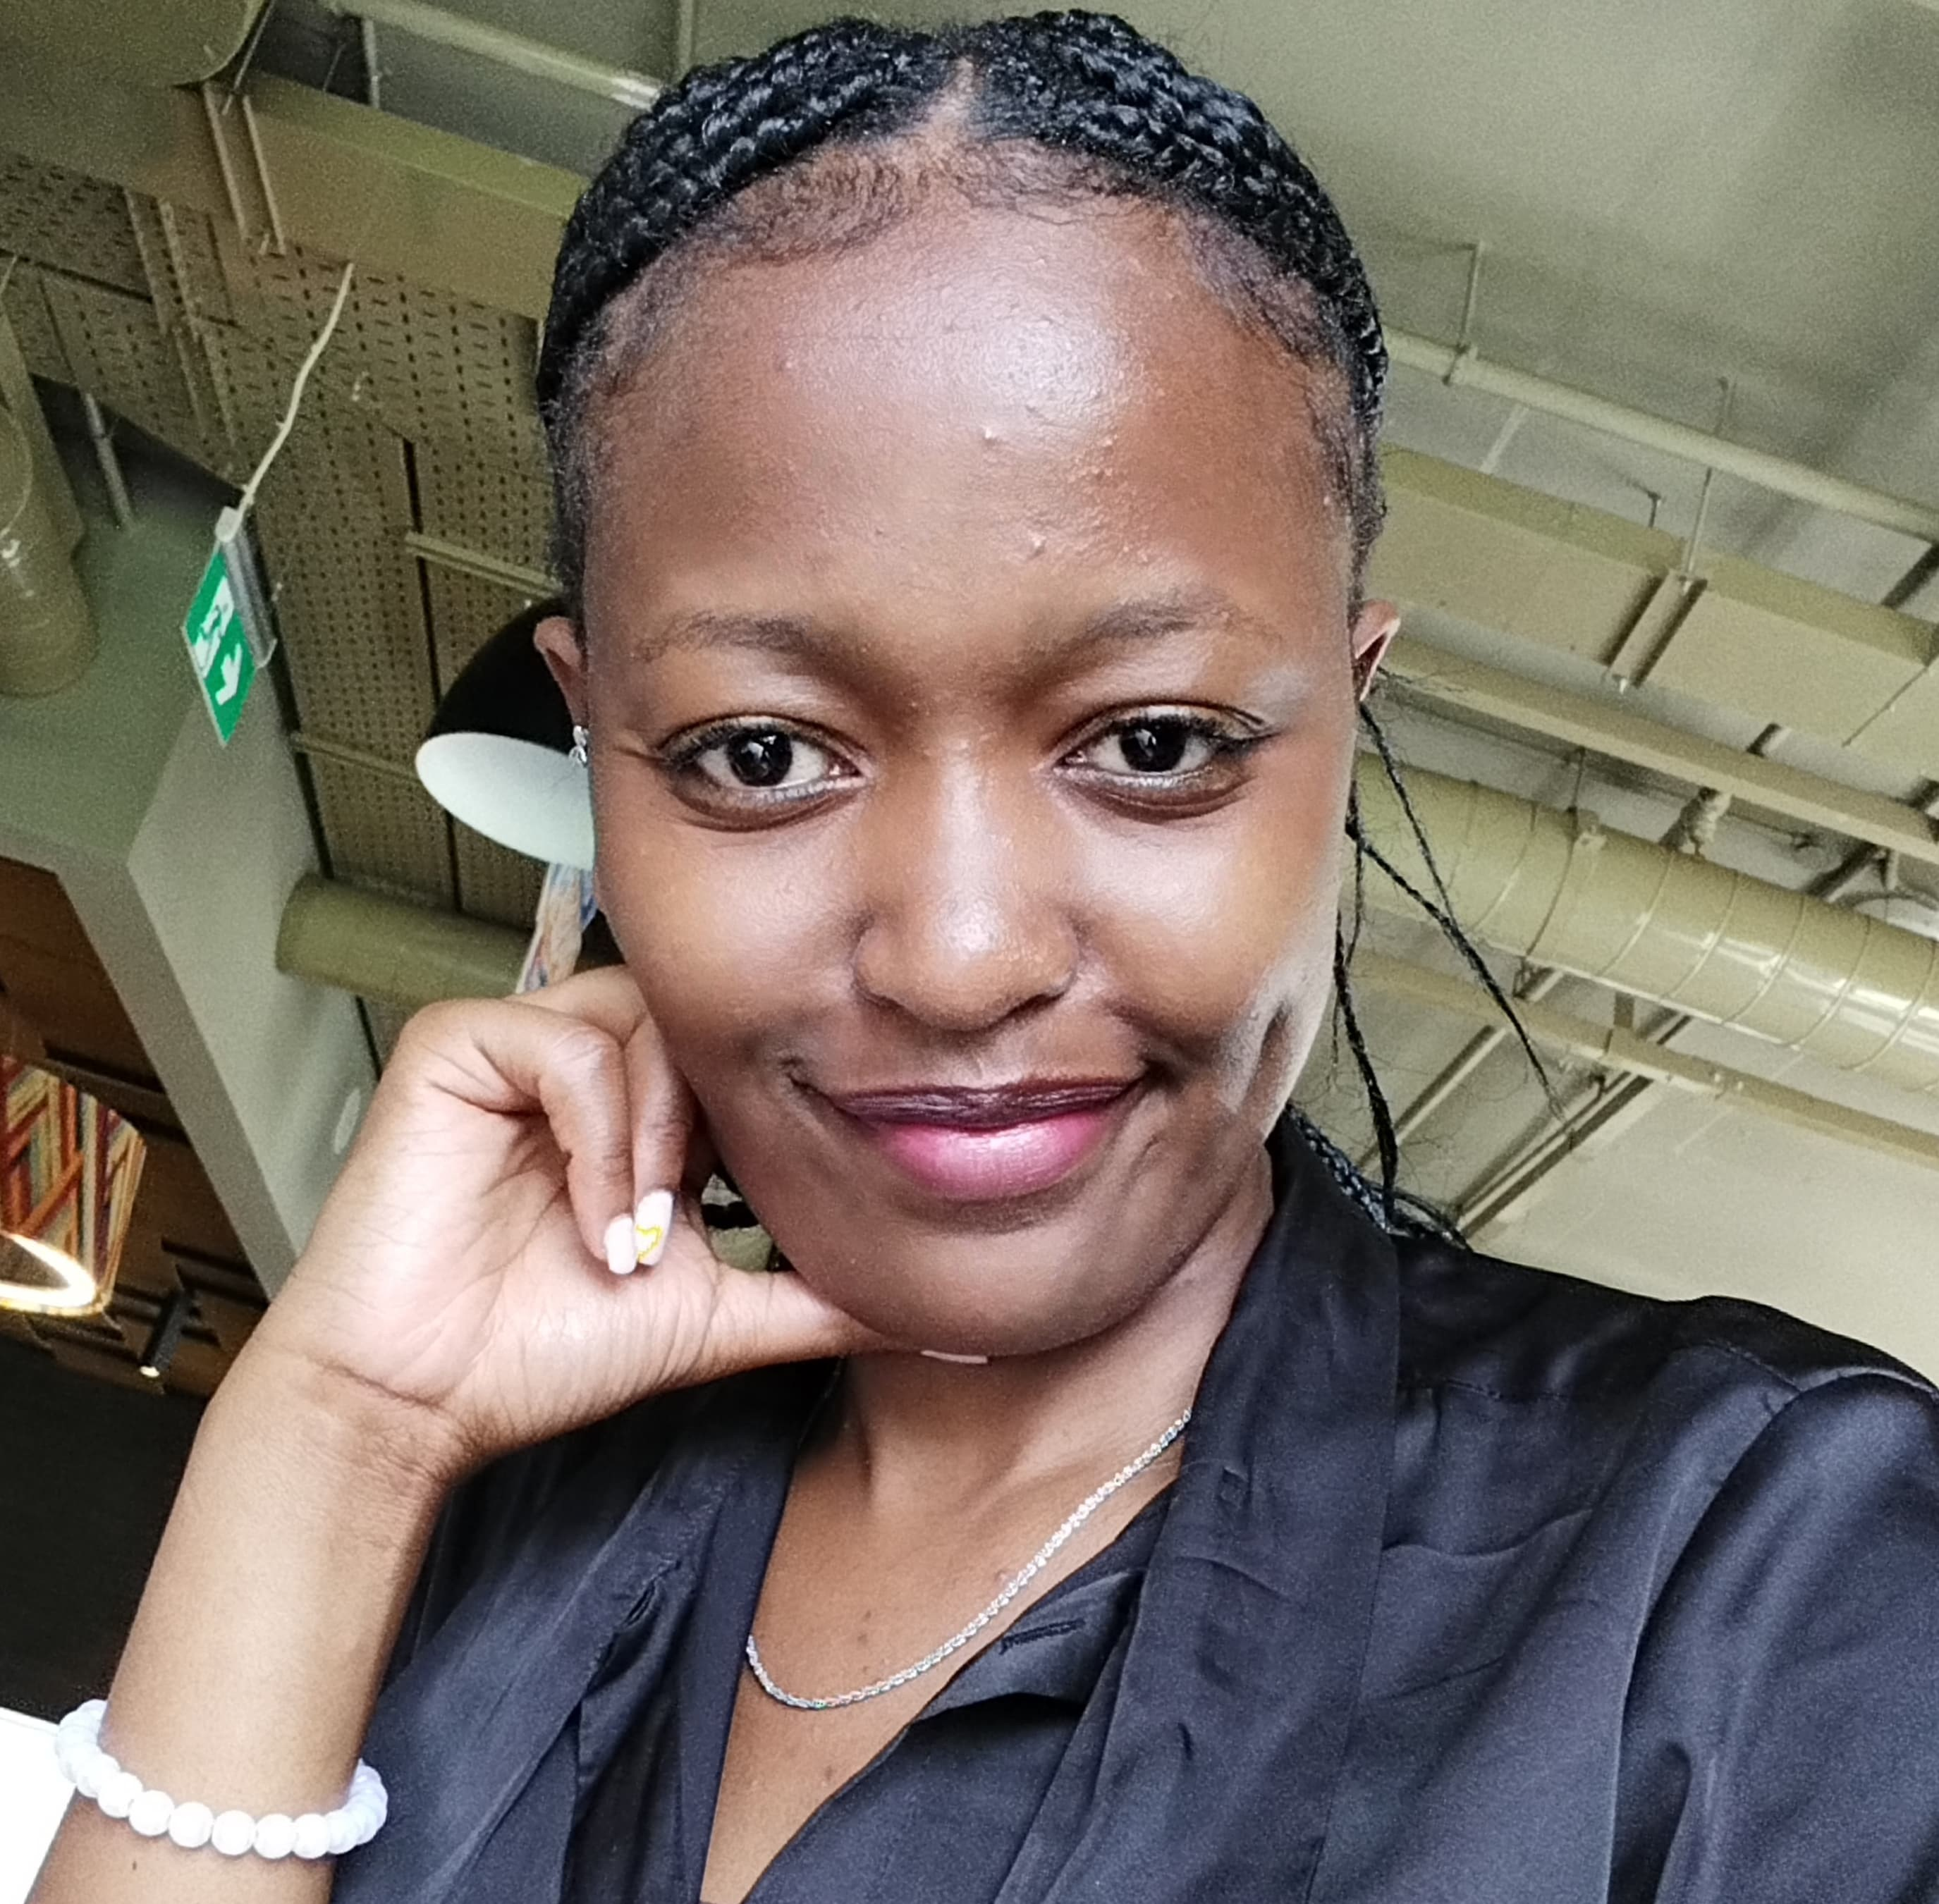
KARIITHI ANNE WANJIKU
ELECTRONICS AND COMPUTER ENGINEER
Embedded systems enthusiast
Electronics and PCB Design and Fabrication
CAD Designs(AutoCAD- Fusion 360)
UI Design (Flutter Flow)
ML

Slide 2
Life
I am a visionary leader , an upcoming engineer aspiring to provide a more stable state of life through technology and innovation.

Slide 3
work
Building solutions to provide health solutions to underprivileged communities.
My professional journey is characterized by a series of dynamic roles and contributions.
1
Championed the integration of technology in health and high school education
2
Actively engaged with WAAW, SES, CODE-ARC,
3

Slide 4
Influence
I have been privileged to hold leadership positions in my journey at the university.
Advocacy
JKUAT, EBK, HUAWEI
Thought leadership
Mentorship and guidance
SES, WAAW, CODE-ARC
CODE-ARC, WIT, SES, KHUZA SCHOOL

Slide 5
Projects
During my time at the university, I worked on several projects. The Nakuja and ICMS Kit projects would mark my best work.
Others
Nirvana, Dojo, AAA Network
NAKUJA PROJECT
ICMS
N3 Rocket Fabrication
Intelligent Cardio Monitoring System

Slide 6
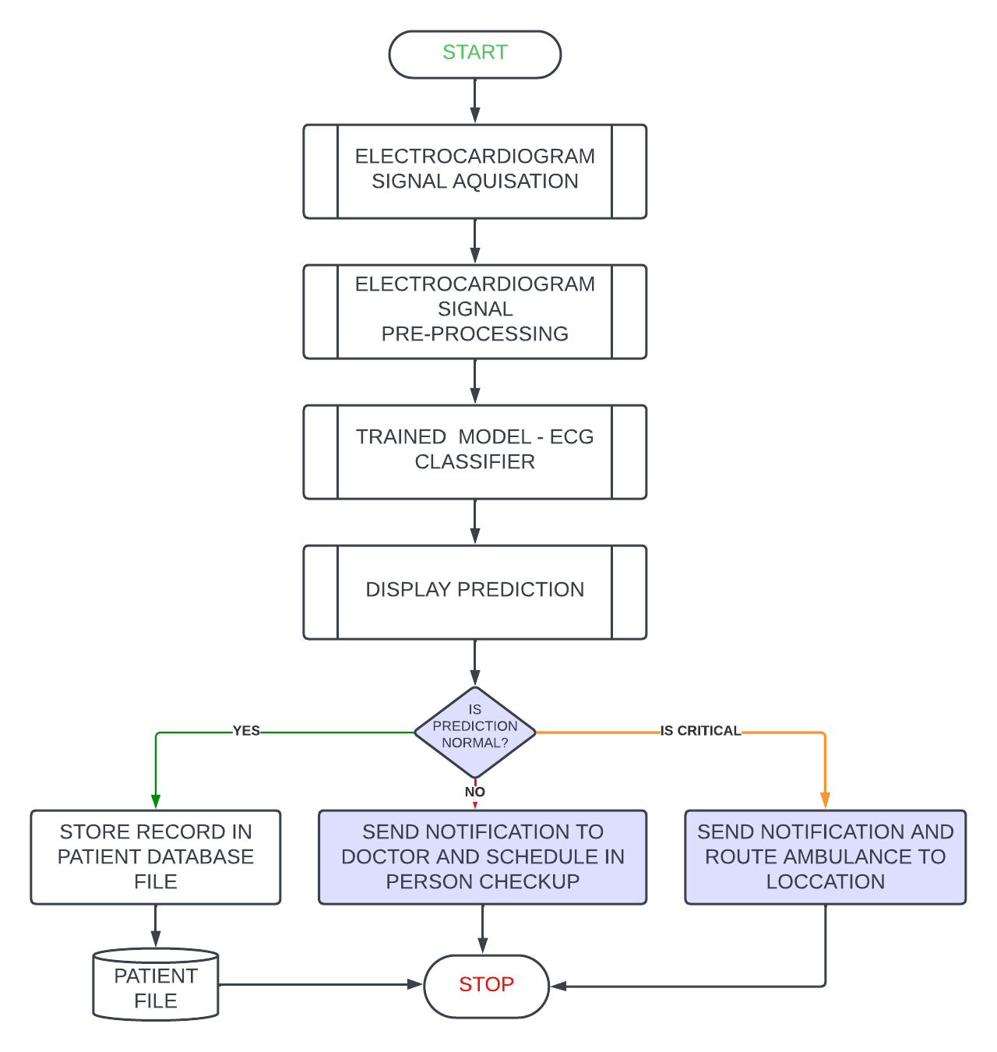
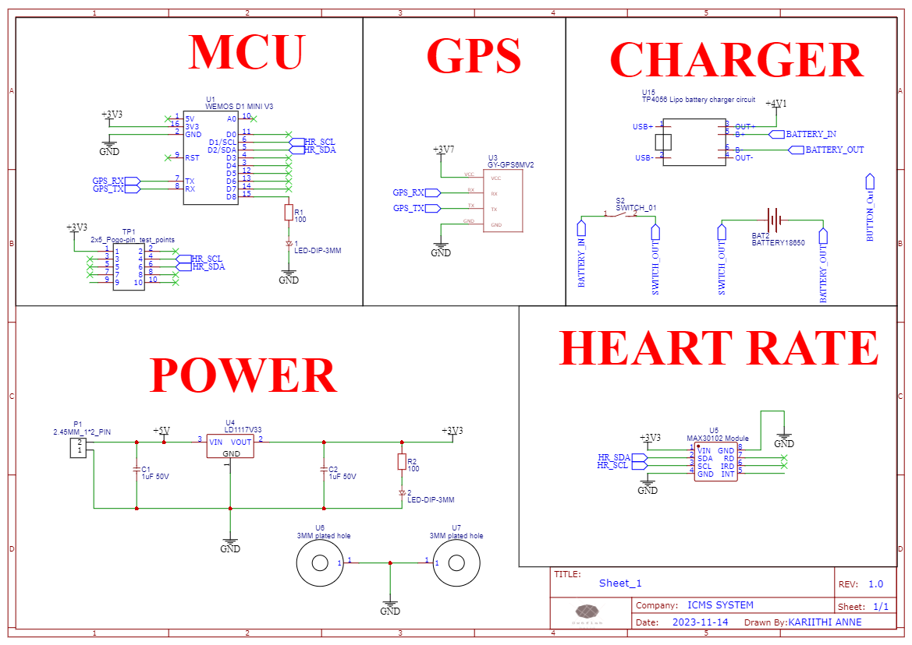
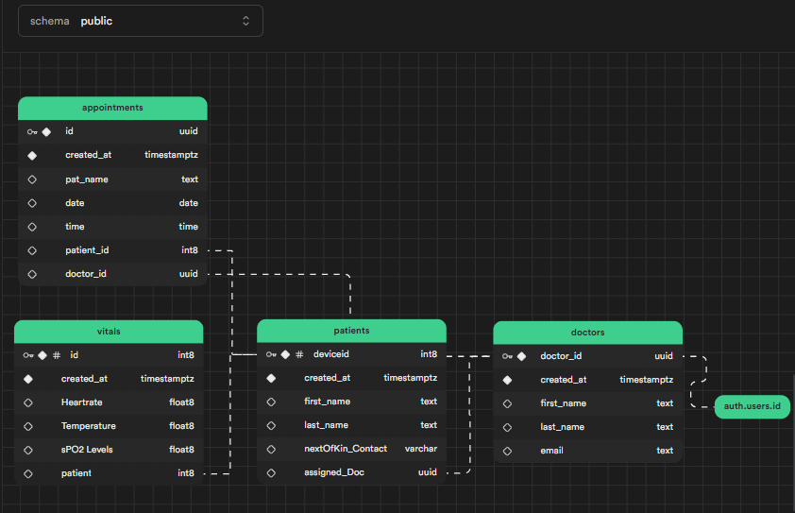
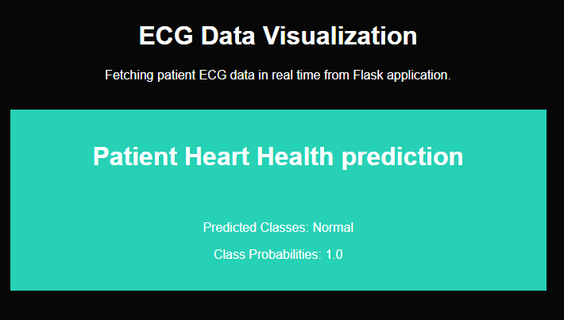
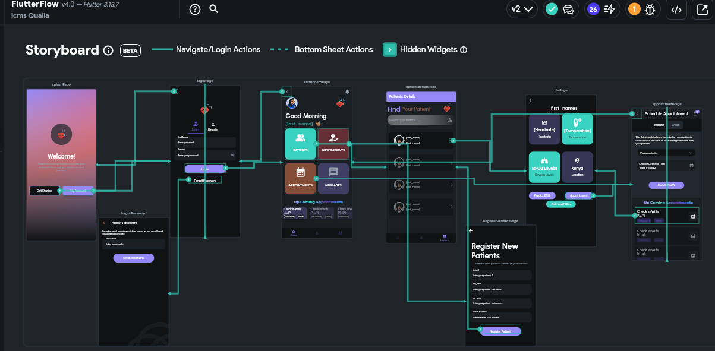




Icms
2.ICMS KIT
3.DATABASE
1.FLOWCHART
5.FLASK- MODEL PREDICTION
4.ICMS APPLICATION
Need for continuous heart activity monitoring.
Need for economical remote ECG systems
Poor response to emergencies
resulting to rise
in mortalities.
Inadequate resources for long-term remote heart monitoring in Kenya.

Slide 7
Icms
1.FLOWCHART
2.ICMS KIT
3.DATABASE
5.FLASK- MODEL PREDICTION
4.ICMS APPLICATION

Slide 8
NAKUJA
Part of the N3 team that designed, built, and launched the third series of the Nakuja rocket
1st author (Design and computational analysis of the Nakuja N-3 rocket)
Improving the flight performance by increasing the flight apogee from 500m to 2000m.
2nd author(Design analysis and simulation of a Launchpad for the Nakuja N3 rocket)
Improved the design of the rail has lower stresses on the rail and by extension smaller deflection during lift-off.

Slide 9





AWARDS & RECOGNITION
Outside the classwork, my work has been recognized by various awards and honors.
PROFESSIONAL EXCELLENCE, SRI
REGIONAL AND GLOBAL WINNER 2023
AWARDED BEST CHAIRPERSON ,2022
IMPACTFUL CHANGEMAKER
(JKUAT-EABL, ROBOTICS DOJO)
Design of n3 rocket and launch

Slide 10
legacy
Long-term influence
Enduring relevance
Inspire future gens
Continuing projects
Enduring values
Effective principles

